Slide 1
Are you ready? Medical Students are coming to your hospital
Suzanne Maranda
Head, Health Sciences Librarian
OLA Superconference 2017

Slide 2
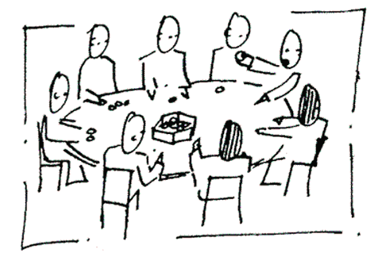
Why are you here today?
Introduce yourself at your table:
Name
Hospital
What you hope to learn at this session

Slide 3
Learning outcomes
Identify resources most used by medical students to inform collection management decisions
Identify barriers to information access to determine how best to address them in a clinical setting
Identify knowledge gaps to address continuing education needs of young clinicians.

Slide 4
Outline
Medical Information Literacy at Queen’s University
March 2016 survey
Confidence levels
Resource use
Barriers to use
Information seeking skills
Actions for hospital librarians

Slide 5
Information literacy in the medical curriculum
 | YEAR 1 | YEAR 2 | Clerkship, Years 3 + 4
Course | CARL: Critical Appraisal, Research and Learning Fundamentals of Therapeutics | Critical Enquiry (CE) | Clinical rotations
Integrated Medical Information Literacy (MIL) | 3 online modules and 3 in-person sessions. Content: e-books, POC tools Medline/PubMed searching Drug information resources. | 1 in-person session on advanced searching, new databases, etc. Individual meetings with a librarian. | Quick review of point-of-care tools and mobile apps (Fall of Year 3)
Assessment | CARL assignments with MIL components Drug Literature Evaluation project linked to Therapeutics course | Critical Enquiry projects. Lit searches assessed by librarian during consultation. | Mini-Scholar Exercises (MSE) test MIL as well as EBM* skills. One per rotation (8).
*EBM: Evidence-Based Medicine

Slide 6
Goals of research project
What are the students’ attitudes and confidence regarding information access and Evidence-based medicine (EBM)?
Do they maintain, forget or enhance their information literacy skills during clerkship?
Which resources are used by medical students during clerkship?
For clinical work
For the mini-scholar exercise
What would stop them from using resources?
Can this information be helpful to hospital librarians?

Slide 7
Survey demographics
Graduating class of 2016
53 students (class total 99)
March 2016
In class, paper survey
Age groups | N
24-26 | 32
27-29 | 16
30-33 | 4
Survey components: 1. Confidence levels
2. Resource use and barriers to usage 3. Knowledge questions

Slide 8
Quotes about confidence
Health care professionals “describe a waning in confidence in their ability to access and critically appraise the literature over time” (Salbach, 2013)
“People who lack the knowledge or wisdom to perform well are often unaware of this fact.”
Inflated self-assessment. Dunning-Kruger effect (1999)
Notes:
Salbach NMPTP, Jaglal SBP, Williams JIP. Reliability and Validity of the Evidence-Based Practice Confidence (EPIC) Scale. Journal of Continuing Education in the Health Professions. 2013;33(1):33-40.
Kruger J, Dunning D. Unskilled and unaware of it: How difficulties in recognizing one's own incompetence lead to inflated self-assessments. Journal of Personality and Social Psychology. 1999;77(6):1121-34. doi: 10.1037/0022-3514.77.6.1121.

Slide 9
Notes:
Poll Title: How confident are junior clinicians about their information seeking skills? https://www.polleverywhere.com/multiple_choice_polls/5ZCjN4U6x6dsxNQ

Slide 10
Confidence in MIL skills

Slide 11
Group Activity
List of resources on tables – yellow page
Rank them in order of usage by clerks for day-to-day use
Do we agree on their top choice?
Do we agree on their bottom choice?
Notes:
Images from Yahoo images “free to use and share”

Slide 12
Resources used for clinics

Slide 13
Mini-Scholar Exercise (MSE)
Clerks pick a clinical encounter
Develop a question and research it
They follow the EBM steps
What do you think happens to the list of resources now used for the MSE? Will the order change?

Slide 14
Resources used for the Mini-Scholar Exercises (MSE)

Slide 15
Number of resources used for the MSE

Slide 16
Group activity
Make a list of potential barriers to resource usage in your hospital setting.
Do you agree as to which one(s) are the most common?
Use the pink sheet on your tables to rank the barriers identified by clerks

Slide 17
Barriers to resource usage
Notes:
Other: mostly cost of buying own resource, usually UTD

Slide 18
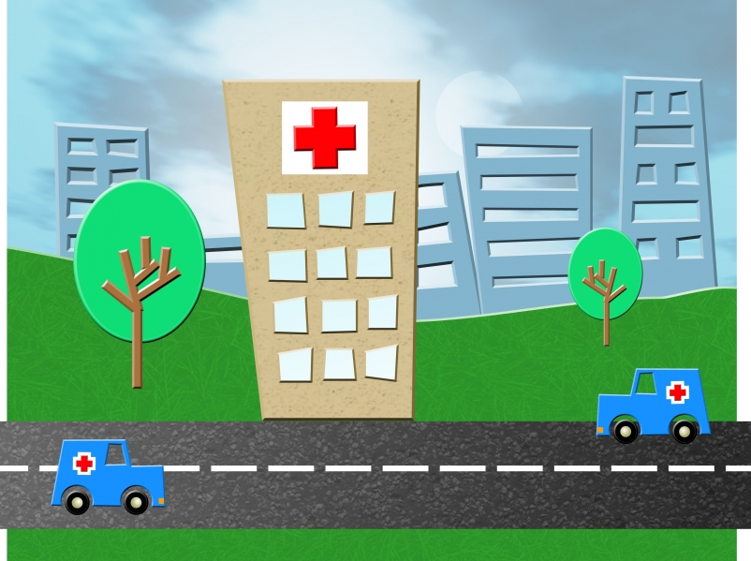
Group discussion
Can these barriers be addressed at your hospital?
Notes:
Image from Yahoo images, free to use and share

Slide 19
Notes:
Poll Title: Two years after the last of the formal MIL sessions, and after preparing 8 mini-scholar exercises, how are their information seeking skills? https://www.polleverywhere.com/multiple_choice_polls/4HTtVVsWK2rPsht

Slide 20
Knowledge questions - MCQ
To find recent peer-reviewed articles on the occurrence of AIDS in children, the most effective search would be performed in:

Slide 21
Knowledge questions - MCQ
At her next visit, your middle aged patient comes with a printout of a website on arthritis where it is recommended to use glucosamine as an effective alternative therapy. Which freely available and reputable patient education resource would you recommend ?

Slide 22
Knowledge questions – True/False

Slide 23
Distribution of knowledge scores
Notes:
Average 5/11 – not great, did better with MCQs than with True/False: many chose “don’t remember”

Slide 24
Group activity
Brainstorm re types of activities/actions that could be done to reach out to, and help this particular group of new clinicians achieve successful information access.
Are there 1 or 2 from this list that you think you could do very soon?
I wish you many successes - I’d love to hear from you
Notes:
Based on all info re barriers, knowledge, resources
Some ideas: Tip of the week, Handouts, Facebook/Twitter, Formal CE sessions/buying apps or getting with purchases/working with IT re wifi

Slide 25
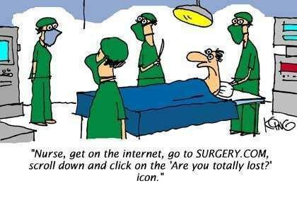
Questions?
http://jokes.lipy.com/nurse/internet-surgery#sthash.4EkPobIz
Notes:
I need your help to make sure this does not happen!

